Slide 1
Size- and stage-
structured Models
Notes:
a

Slide 2
Estimation Methods (Overview)
Age
structure
Spatial
structure
Lumped
models
Size
structure
Trophic
interactions

Slide 3
Stage-structured models
(The basics)
Applicable when:
  Animals cannot be aged / the growth curve is indeterminate (i.e. t₀ cannot be determined).
  The duration of a stage is not the same for all stages.
  The primary source of data is stage/size-composition information.
Hierarchy of size-structured models:
  Various “data-poor” size-based methods of stock assessment exist – most are very biased.
  The size-structured models outlined here are based on the “Integrated Analysis” paradigm.

Slide 4
Stage-structured models
(Examples)
Models of species such as trees (seeds in a seedbank, new trees, canopy) where stage duration differs markedly among stages.
Size-structured models where each stage is a size-class.
Semi-age-structured models (e.g. a model of a whale population where the adult females are divided into those calving, those resting following calving, those available to give birth).
Stages can be: (a) the area in which an animal is found, or (b) its maturity stage.

Slide 5
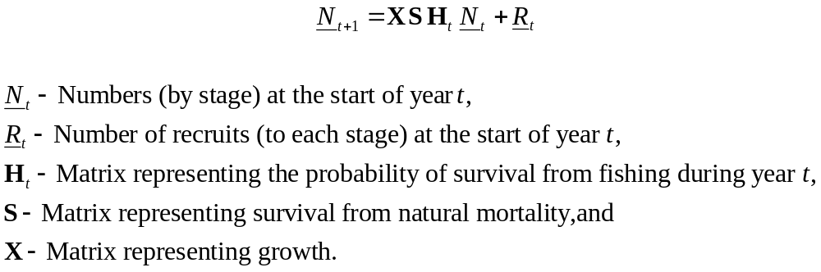
Stage-structured models
(The equations)
Stage-structured models are constructed in the same way as age-structured models, except that the basic dynamics are size- rather age-structured, i.e.:

Slide 6
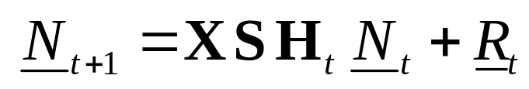
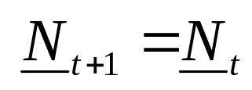
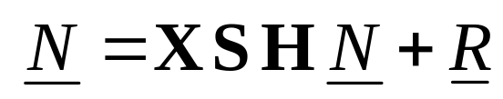
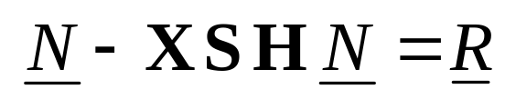
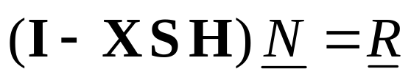
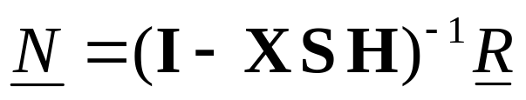
Equilibrium
It is often necessary to find the equilibrium of a stage-structured model. Starting from:
In equilibrium so:
or
Thus:
or

Slide 7
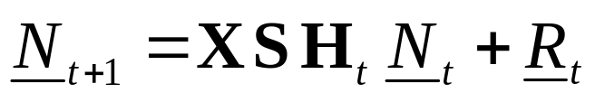
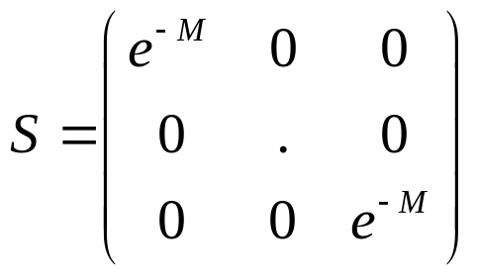
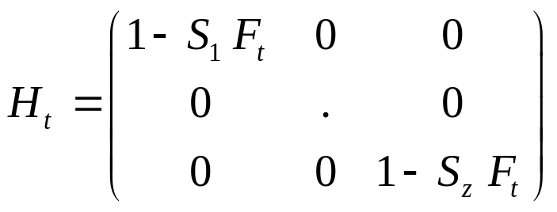
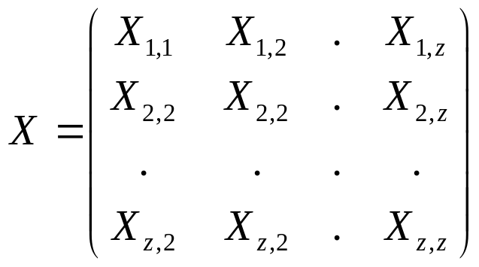
Size-structured models
( expanded)
Natural survival
Harvest survival
Growth
The matrix X is often constrained to prevent “negative growth” (e.g. lobsters, abalone)

Slide 8

A size-structured model with a terminal molt
Consider the following size-structured model:
animals are divided into mature and immature stages;
all recruitment is to the immature class;
there is no negative growth; and
once animals mature they stop growing.

Slide 9
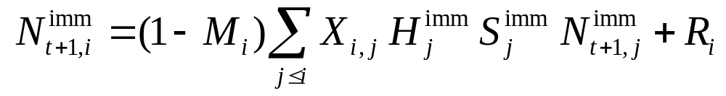
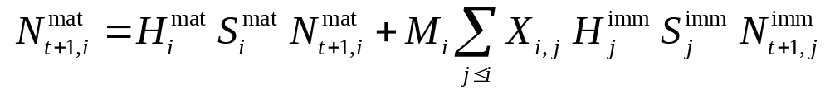
A size-structured model with a terminal molt
Probability of maturing (after growth)
Mature animals
never grow again
Immature animals that
molt and then mature

Slide 10
Exercise-I
A population is found in two habitats (inshore and offshore).
Growth in the inshore habitat is faster than in the offshore habitat, but (natural) survival is lower inshore than offshore.
The population is divided into three stages (recruits, post-recruits, and adults).
There is a fishery for the population, with 20% of the effort inshore and 80% offshore. The fishery only catches mature animals (stage 3) and after half of natural mortality.
All recruits are to the inshore area (first stage), but animals migrate (after survival and before growth) from the inshore to the offshore area over time.
Recruit is constant and equal to 1.

Slide 11
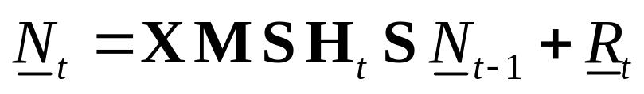
Exercise-II
Mathematically, the state variable consists of six elements (three stages x two areas) and the model can be represented as follows:
Numbers-at-age
Half of survival
Recruitment
Movement
Survival from fishing
Growth

Slide 12
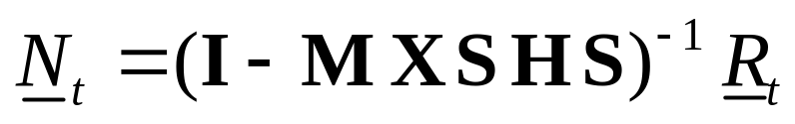
Exercise-III
Tasks:
In-class: Find the equilibrium stage structure as a function of fishing effort (q=1 for both areas) and plot the catch and the number of spawners (stage 3 in both areas) as a function of fishing effort. The equilibrium is defined as:
Bonus: Find the level of effort such that the number of mature animals is 35% of that in an unfished state. Hint use uniroot.

